Slide 1



Tumor Images with Doctor Description
Joan Some
SAT4650 Final Project

Slide 2
Project Description
Plan: A program to enable doctors to write a description about tumor images using GUI and save the image and description in a database.
Python modules: mysql , tkinter, PIL.
Dataflow:
Doctor first logs in on a GUI window to access the images.
Doctor selects an image from a directory by clicking on a ‘select image’ button.
The Python program will read the tumor image and display it in a Canvas GUI widget.
Doctor can view, analyze the tumor image, and enter some notes in a text box to describe the tumor. The doctoral notes will be displayed below the images.
The doctor then saves the image and description data in a database which can be later inferred to.
Input: a tumor image
Output: a tumor image with doctor description.

Slide 3
Long-term goal
An improved efficient application used to view tumor images for evaluation by a doctor and then the data (tumor image and description) is stored in a database.
Addition functionalities for the application:
Once an image has been opened, assessed by a doctor and saved in the database along with the description, the image can be deleted from the directory with the original images. This leaves only images with no description in the folder.
Work on how the saved images with descriptions can be displayed. Other medics can then open the images from the database and check the descriptions.

Slide 4
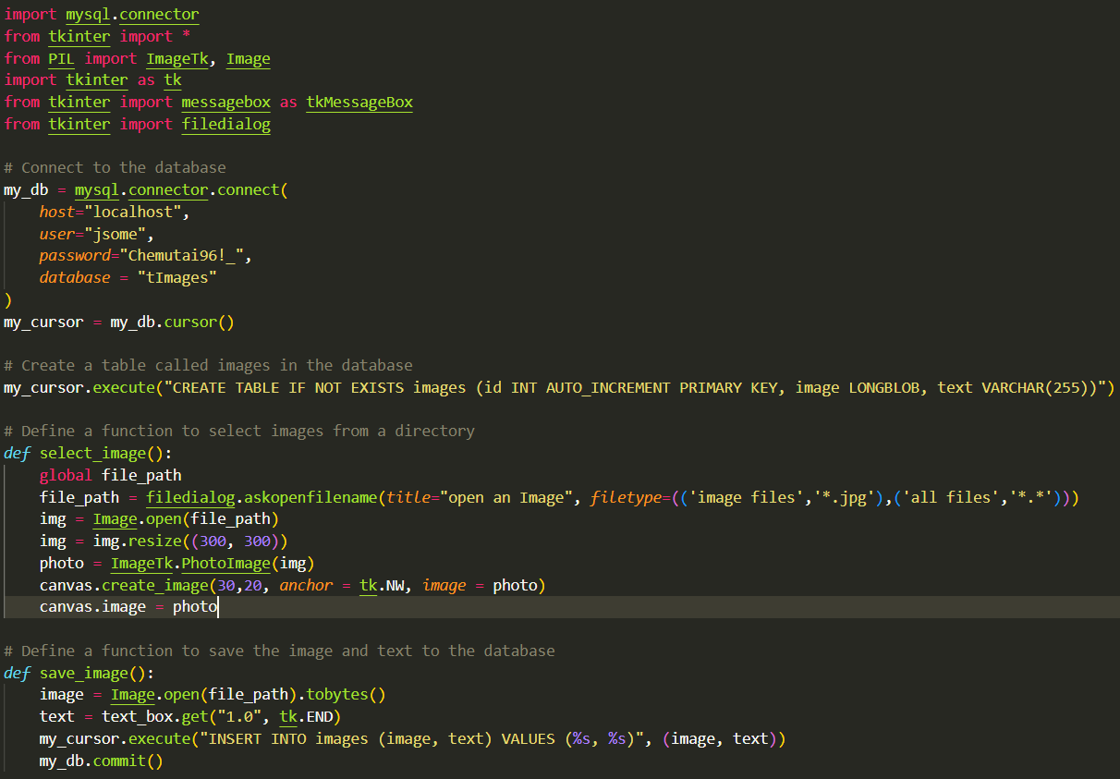

Slide 5
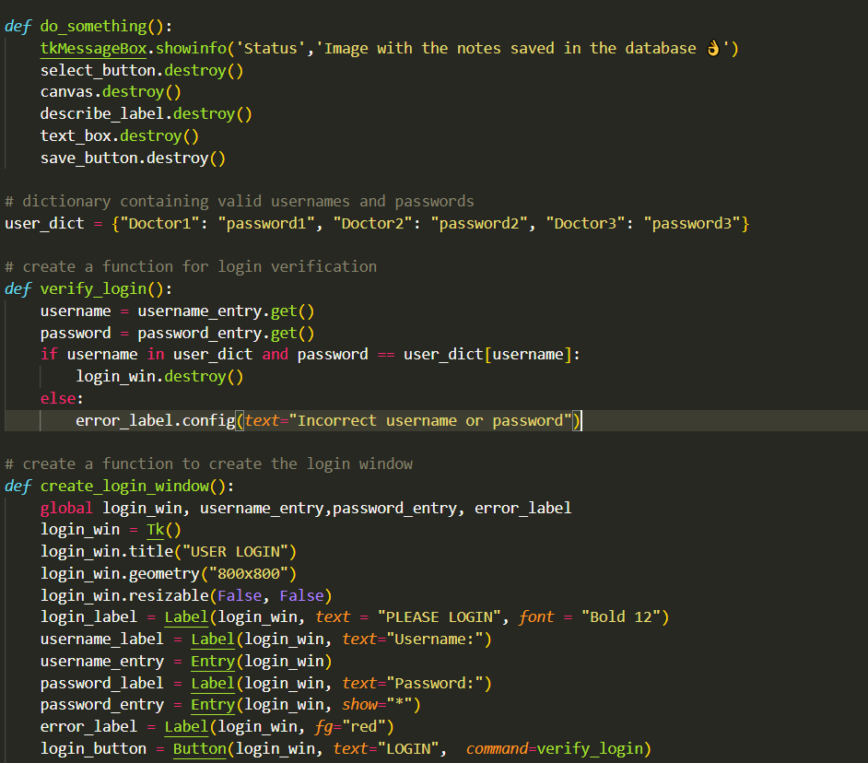

Slide 6
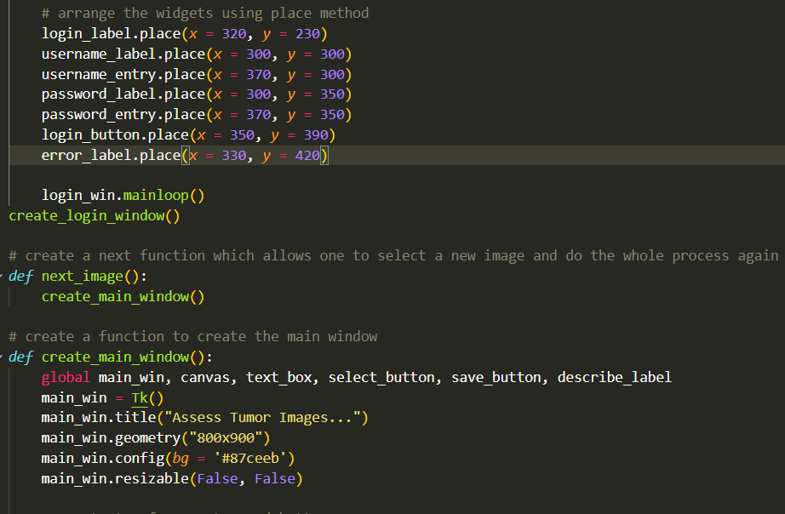

Slide 7
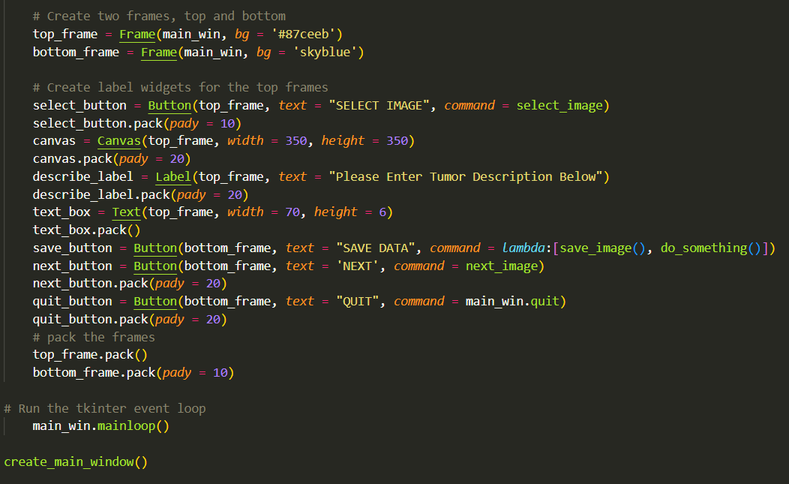
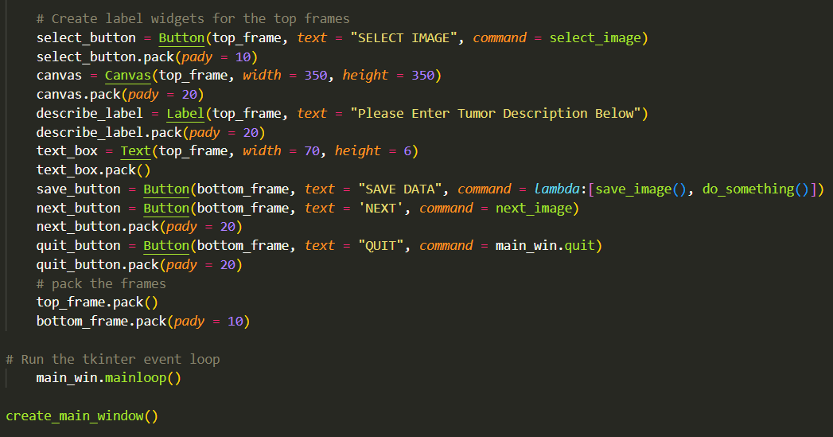

Slide 8
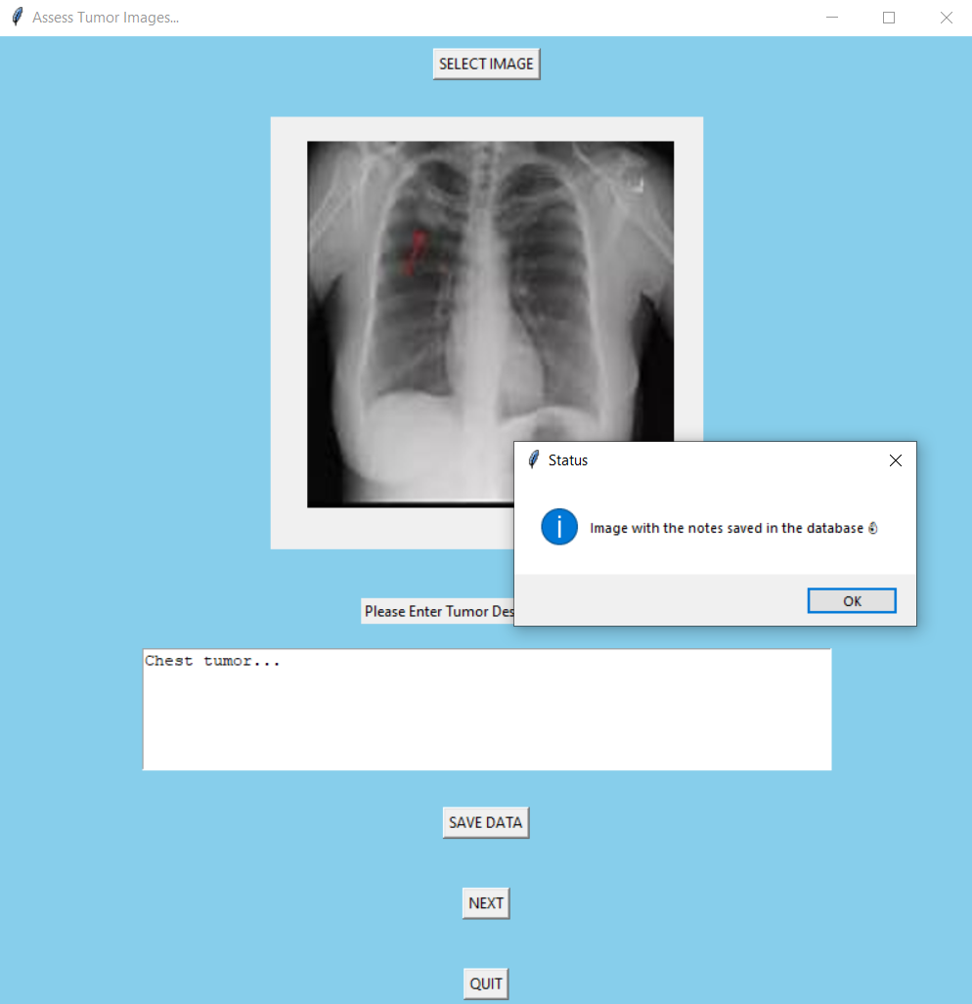
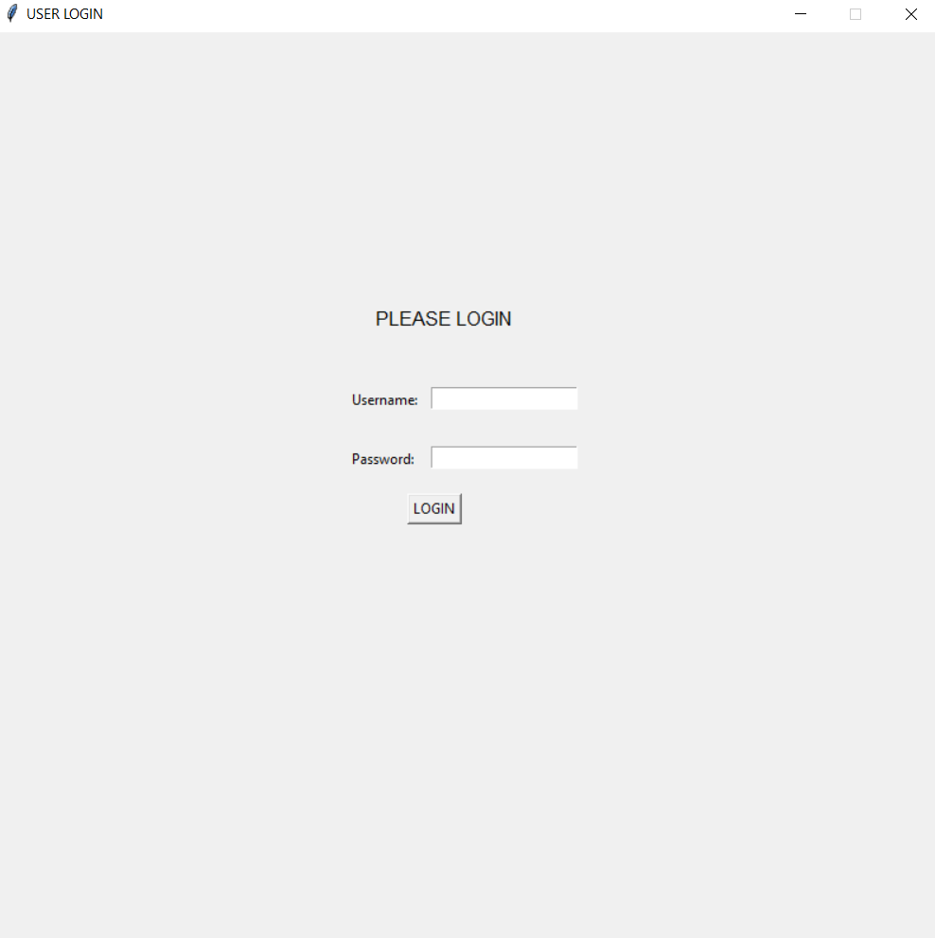
Results

